Slide 1


Data-Driven Decision Making at Zomato
Transforming Food Delivery and Discovery Through Data Science.
Presented by: Desai Hardik
Date: [25/06/2025]
by Desai Hardik
DH
Notes:
1

Slide 2
Company Overview: Zomato
Origins
Core Services
Key Metrics
Founded: 2008 in India
Food delivery
80M+ monthly active users (est. 2025)
Global Presence: 20+ countries
Restaurant discovery
Online ordering & reviews
Focus: user engagement & optimization
Notes:
2

Slide 3
The Business Problem: Challenges in Food Delivery
Intense Competition
Delivery Issues
Recommendation Accuracy
Facing rivals like Swiggy and Uber Eats.
Delays leading to customer dissatisfaction.
Need for precise restaurant suggestions.
Churn & Abandonment
Restaurant Management
Minimising cart abandonment and user churn.
Optimising performance and pricing.
Notes:
3

Slide 4
Types of Data Collected
User Data
Location, order history, preferences, ratings.
Restaurant Data
Menus, pricing, reviews, delivery times.
Behavioral Data
App interactions, search trends, clickstream.
Real-time Data
GPS, traffic, weather, live delivery updates.
External Sources
Social media mentions, third-party reviews.
Notes:
4

Slide 5
Techniques & Tools Utilised
Machine Learning
A/B Testing
Personalised recommendations and demand forecasting.
Optimising app design and pricing strategies.
Route Optimisation
Clustering Algorithms
Real-time traffic and GPS data integration.
Customer segmentation for targeted promotions.
Natural Language Processing (NLP)
Analysing user reviews and feedback.
Notes:
5

Slide 6
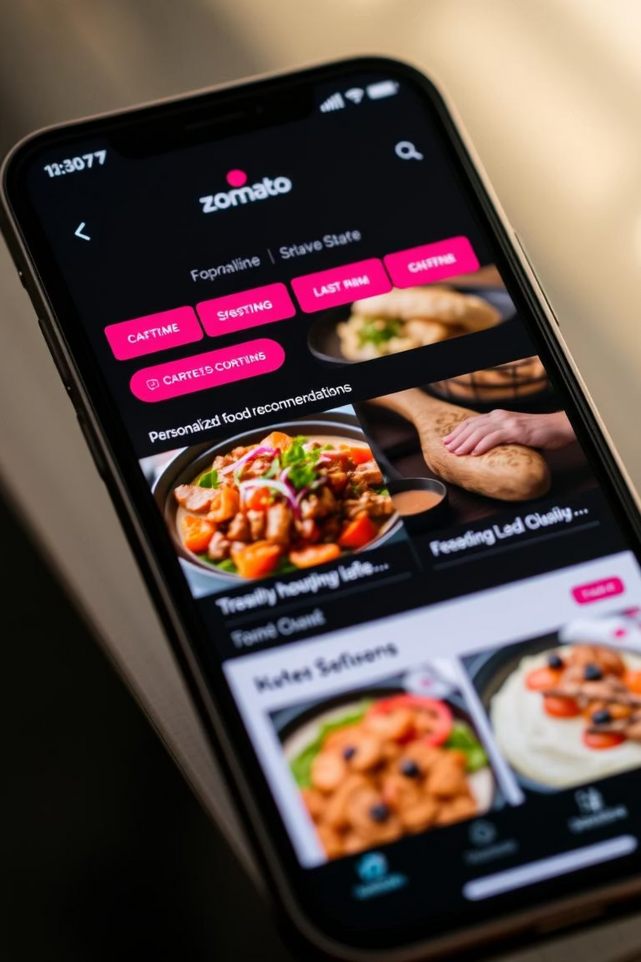




Personalisation & Recommendations
Profile-Based Suggestions
Restaurants and dishes tailored to user profiles.
Learning from History
Adapting to search and order patterns.
Location-Awareness
Suggestions based on current user location.
Outcome
Increased user engagement and higher conversion rates.
Notes:
6

Slide 7
Delivery Optimisation
Estimated Delivery Time
Predictive analytics for accuracy.
Route Planning
Real-time traffic and weather data.
Delivery Partner Assignment
Dynamic algorithms for nearest partner.
Reliability
Minimising wait times for improved service.
Notes:
7

Slide 8
Business Impact: Key Benefits of Data Science
+15-20%
+20%
—
—
Delivery Time Accuracy
Order Conversion
Enhanced Satisfaction
Lower Delivery Costs
Due to better recommendations.
Increased customer loyalty.
Through efficient routing.
—
Data-Driven Onboarding
Optimised restaurant selection and pricing.
Notes:
8

Slide 9








Strategic Insights
User Retention
Operational Efficiency
Personalisation leads to higher repeat orders.
Smart routing saves fuel and time.
Dynamic Pricing
Restaurant Decisions
Offers based on demand, time, and location.
Predictive scores guide user choices.
Notes:
9

Slide 10

Conclusion: Zomato's Data-Powered Future
Data drives every level: search, delivery, review.
Decisions are automated and optimised continuously.
Data science improves customer experience, boosts revenue, and fosters loyalty.
Continuous learning ensures Zomato remains competitive.
Notes:
10

